Slide 1
OR GATE
Input A | Input B | A OR B
1 | 1 | 1
1 | 0 | 1
0 | 1 | 1
0 | 0 | 0

Slide 2

1
1
1

Slide 3
1
1
0

Slide 4
0
1
1

Slide 5
0
0
0

Slide 6
AND GATE
Input A | Input B | A AND B
1 | 1 | 1
1 | 0 | 0
0 | 1 | 0
0 | 0 | 0

Slide 7
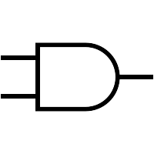
1
1
1

Slide 8
1
0
0

Slide 9
0
0
1

Slide 10
0
0
0

Slide 11
XOR GATE
Input A | Input B | A XOR B
1 | 1 | 0
1 | 0 | 1
0 | 1 | 1
0 | 0 | 0

Slide 12

1
0
1

Slide 13
1
1
0

Slide 14
0
1
1

Slide 15
0
1
0

